Slide 1

Ratings Project
Submitted by-: Raghavulu Patnala

Slide 2
Introduction
This is a Machine Learning Project performed on customer ratings and reviews. Reviews are processed using common NLP techniques.
Millions of people use Amazon and Flipkart to buy products. For every product, people can rate and write a review and rate them. If a product is good, it gets a positive review and gets a higher star rating, similarly, if a product is bad, it gets a negative review and lower star rating. We predicted star rating automatically based on the product review.
The range of star rating is 1 to 5. That means if the product review is negative, then it will get low star rating (possibly 1 or 2), if the product is average then it will get medium star rating (possibly 3), and if the product is good, then it will get higher star rating (possibly 4 or 5).
This task is similar to Sentiment Analysis, but instead of predicting the positive and negative sentiment (sometimes neutral also), here we need to predict the rating.

Slide 3
Analytical Problem In The Project
We Fetch an equal number of reviews for each rating, for example if we are fetching 10000 reviews then all ratings 1,2,3,4,5 should be 2000. It will balance our data set.
Convert all the ratings to their round number, as there are only 5 options for rating i.e., 1,2,3,4,5. If a rating is 4.5 convert it 5.
This Project contains two phases -:
1.Data Collection
2.Model Building

Slide 4
Data Collection
In this phase, we scraped nearly 36000 of reviews data from Amazon of different products like laptop,phone and cameraetc. and it is collected by using Webscraping and Selenium.

Slide 5
Model Building Steps-:
After collecting the data, you need to build a machine learning model. Before model building do all data preprocessing steps involving NLP. Try different models with different hyper parameters and select the best model
1. Data Cleaning
2. Exploratory Data Analysis
3. Data Preprocessing
4. Model Building
5. Model Evaluation
6. Selecting the best model

Slide 6
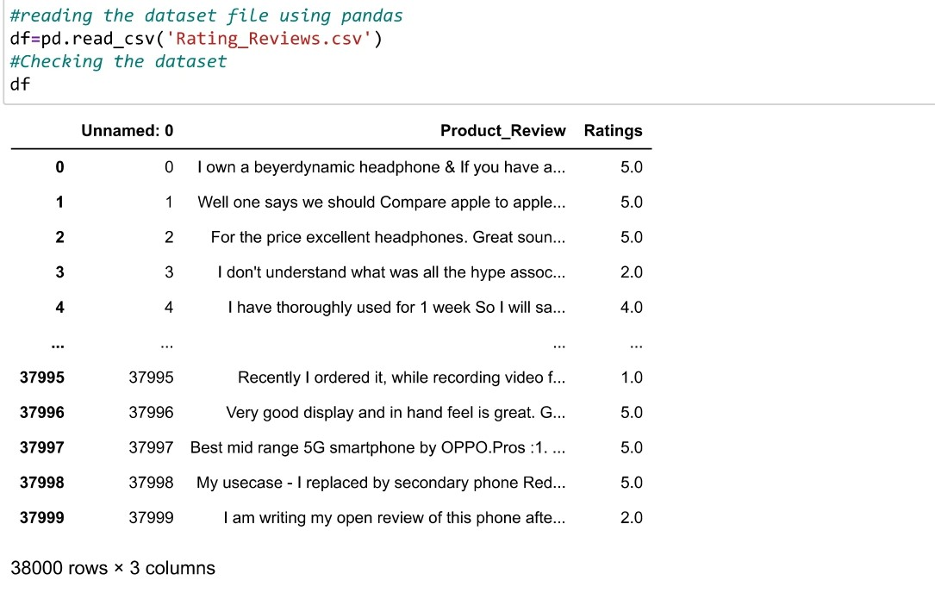
Data Collection And Format

Slide 7
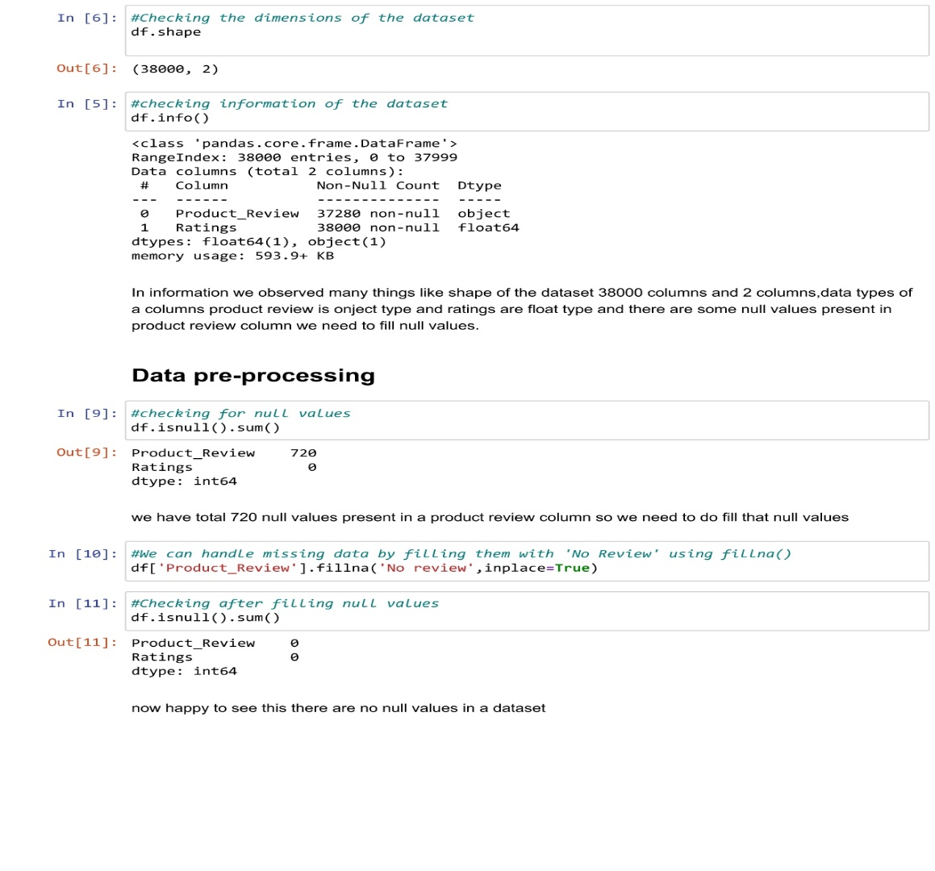
Data Pre processing-I

Slide 8
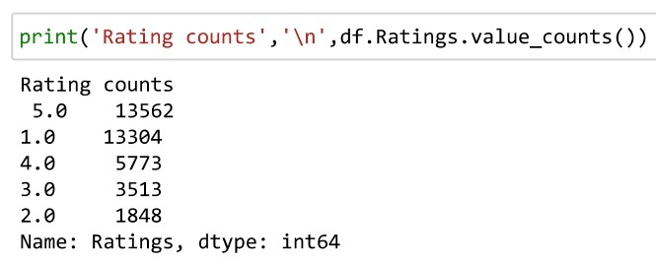
Data Preprocessing -II

Slide 9
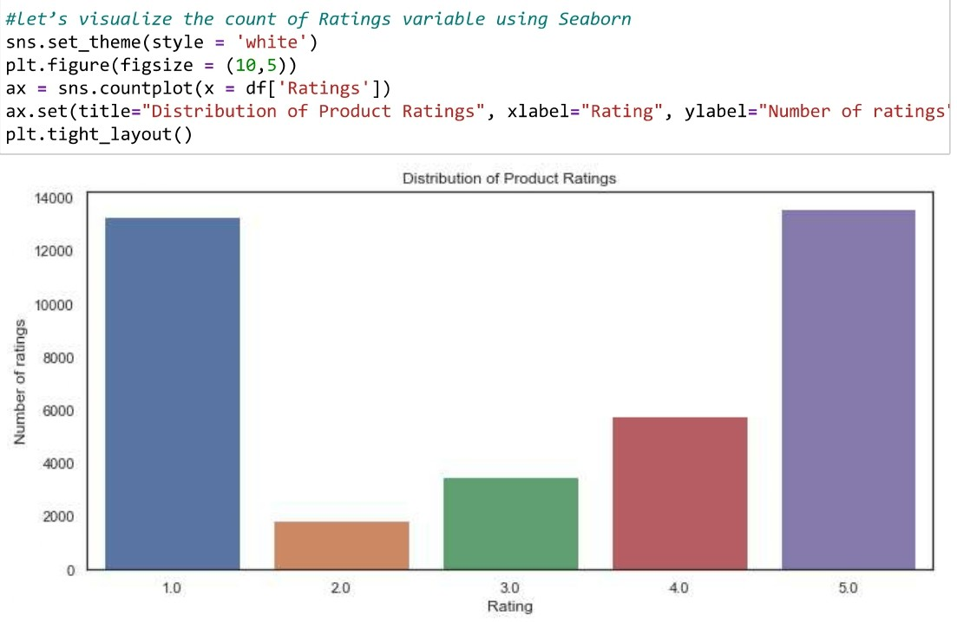
Data Visualization

Slide 10
Pre-processing using Natural Language Processing (NLP):
We cleaned the data using regex, matching patterns in the comments and replacing them with more organized counterparts. Cleaner data leads to a more efficient model and higher accuracy. Following steps are involved:
1. Removing Punctuations and other special characters
2. Splitting the comments into individual words
3. Removing Stop Words
There is a corpus of stop-words, that are high-frequency words such as "the", "to" and "also", and that we sometimes want to litter out of a document before further processing. Stop-words usually have little lexical content, don’t alter the general meaning of a sentence and their presence in a text fails to distinguish it from other texts. We used the one from Natural Language Toolkit a leading platform for building Python programs to work with human language.

Slide 11
Terms of NLP
Stemming is the process of converting inflected/derived words to their word stem or the root form. Basically, a large number of similar origin words are converted to the same word. E.g., words like "stems", "stemmer", "stemming", "stemmed" as based on "stem". This helps in achieving the training process with a better accuracy.
Lemmatizing is the process of grouping together the inflected forms of a word so they can be analyzed as a single item. This is quite similar to stemming in its working but differs since it depends on correctly identifying the intended part of speech and meaning of a word in a sentence, as well as within the larger context surrounding that sentence, such as neighboring sentences or even an entire document.
Then, we will be processing the review and assigning the updated review in the data frame
Finally, we get sense of words for all ratings using WordCloud. Word Cloud is a data visualization technique used for representing text data in which the size of each word indicates its frequency or importance.

Slide 12
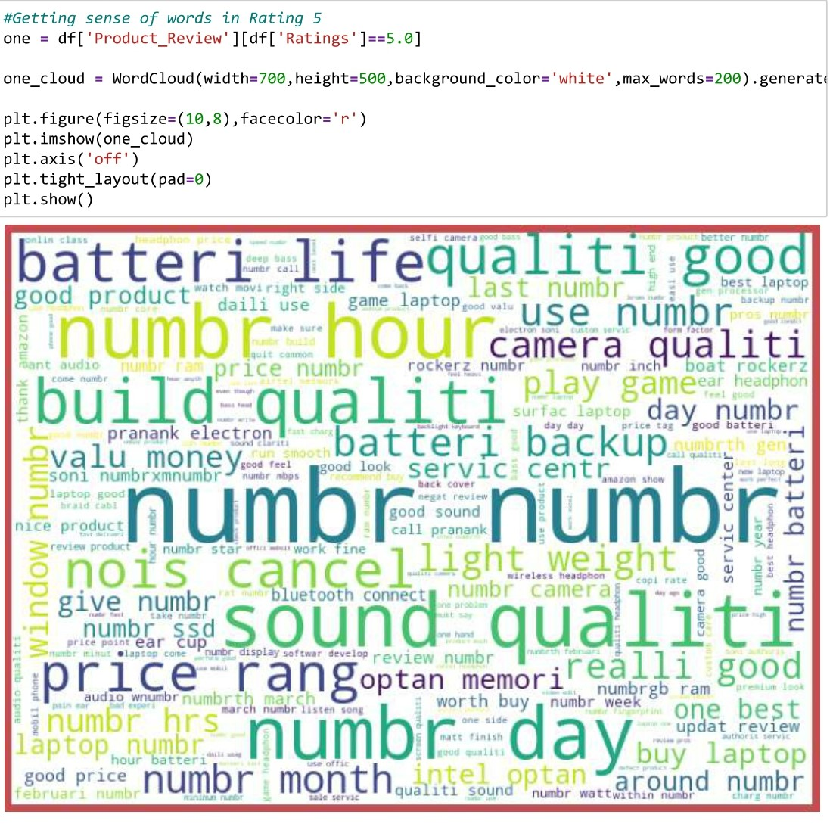
Ratings And Reviews

Slide 13
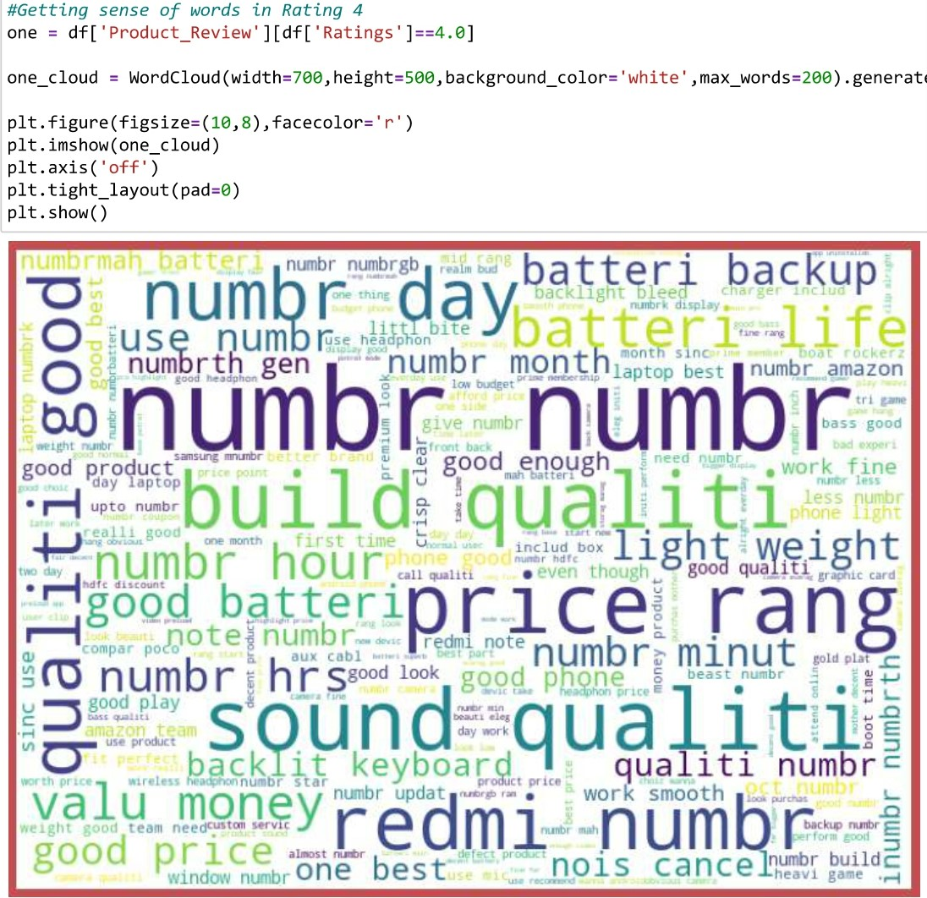

Slide 14
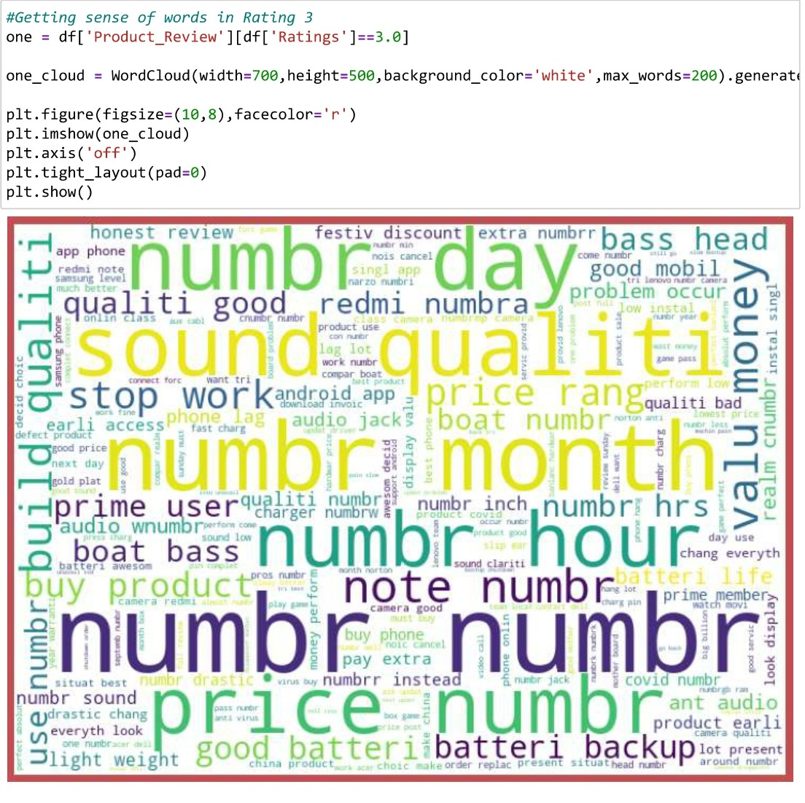

Slide 15
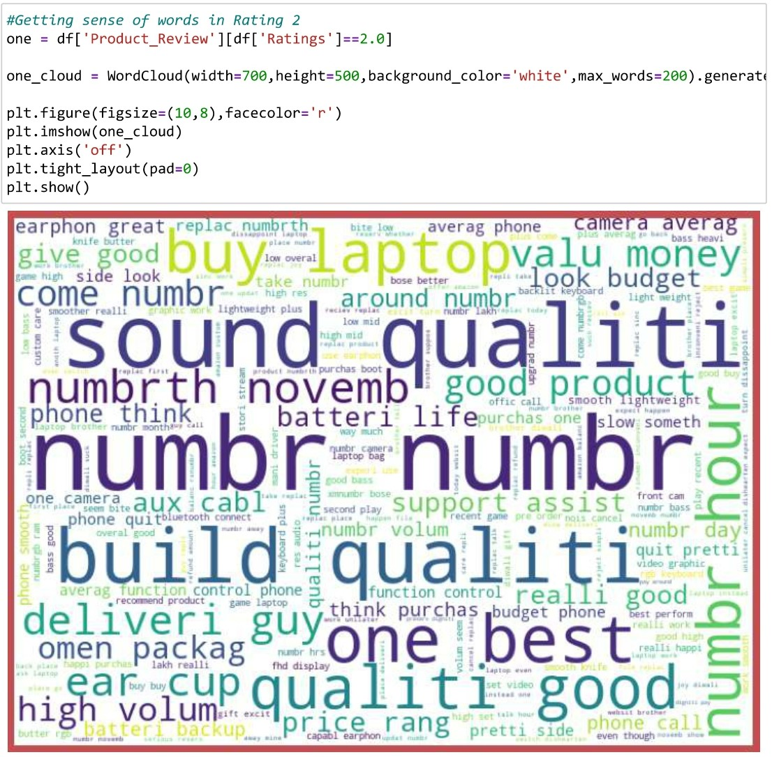

Slide 16
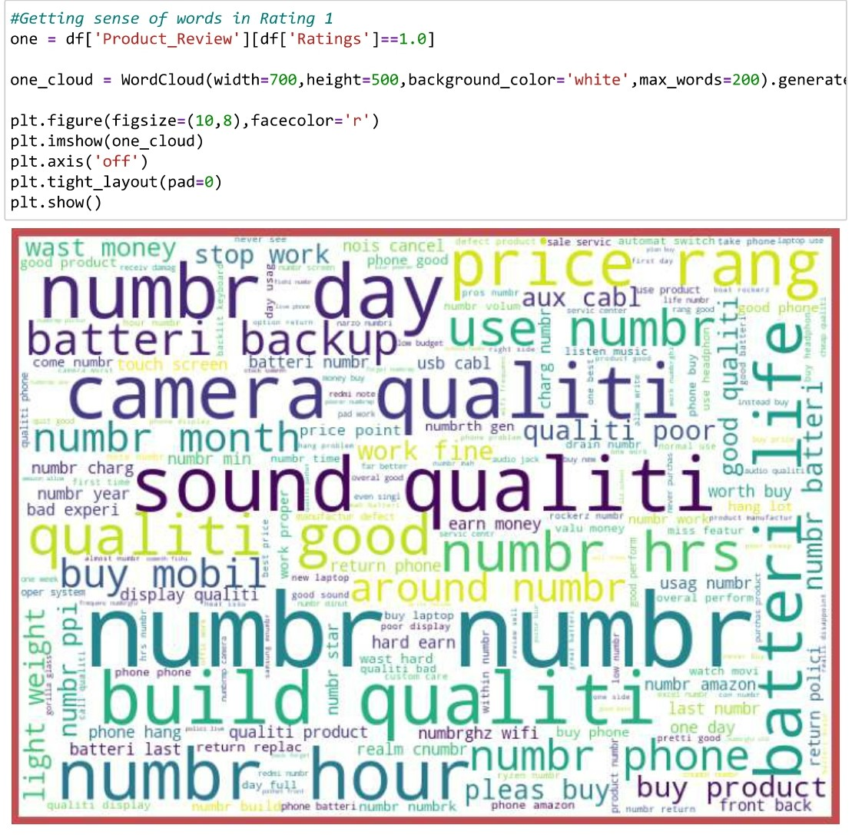

Slide 17


Slide 18
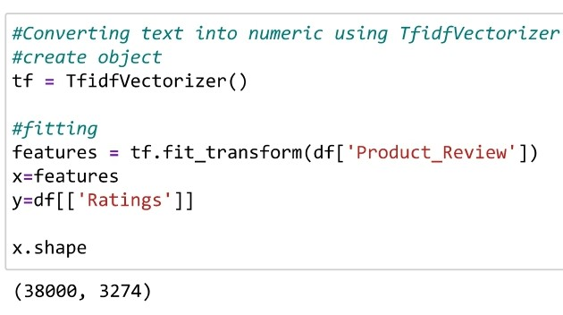
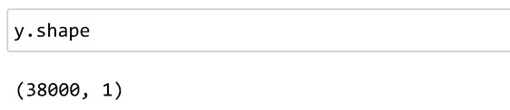
Feature Selection-:
Here we have converted our text into the numeric form.

Slide 19
Hardware and Tools used
HARDWARE:
HP ENVI X360AQ105X
SOFTWARE:
Jupyter Notebook (Anaconda 3) – Python 3.7.6

Slide 20
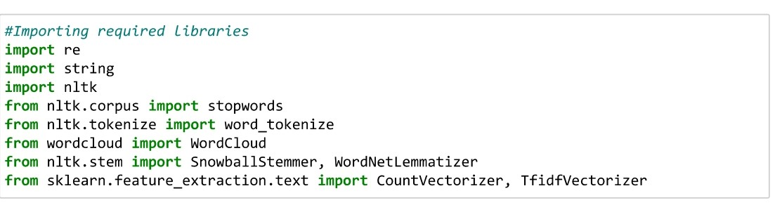
Libraries Used

Slide 21
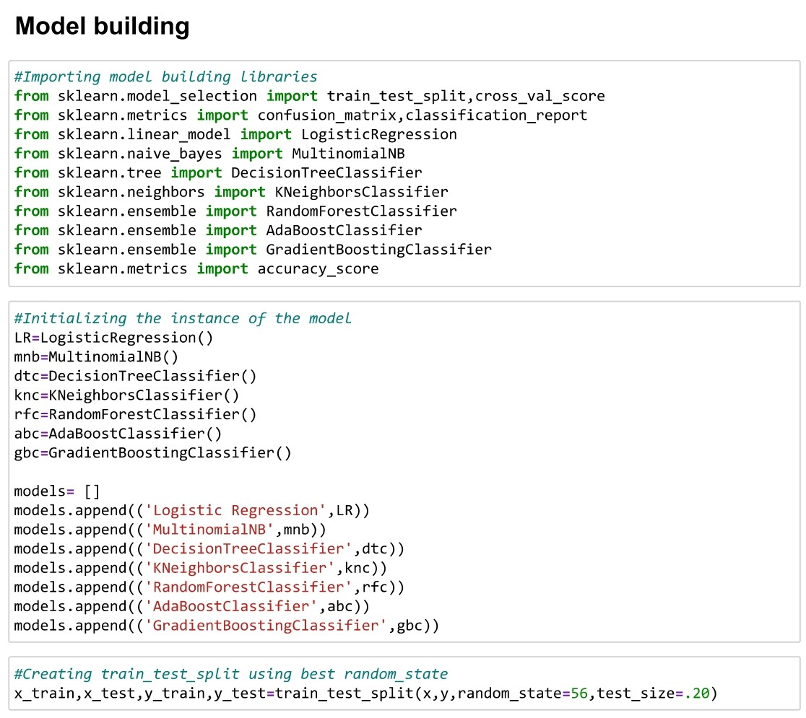
Model Building

Slide 22
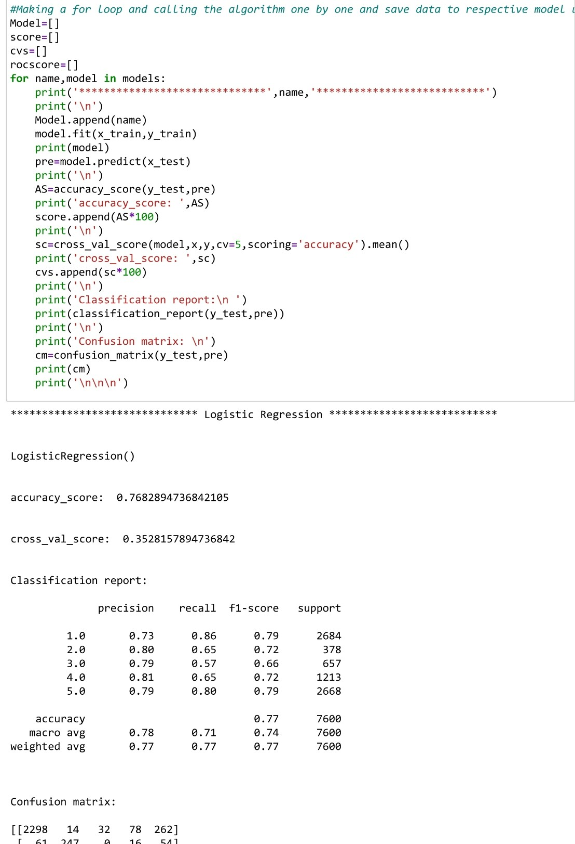
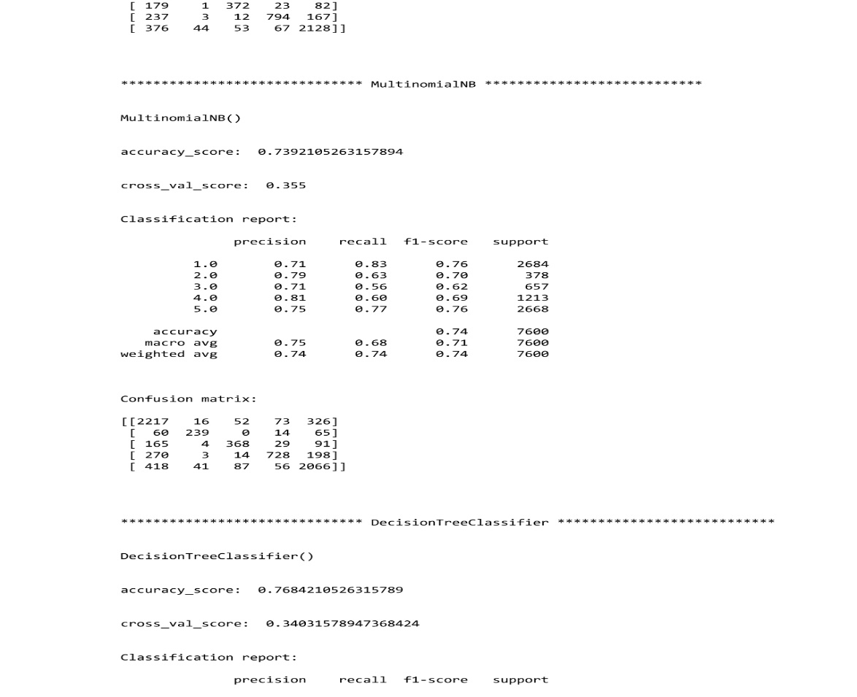
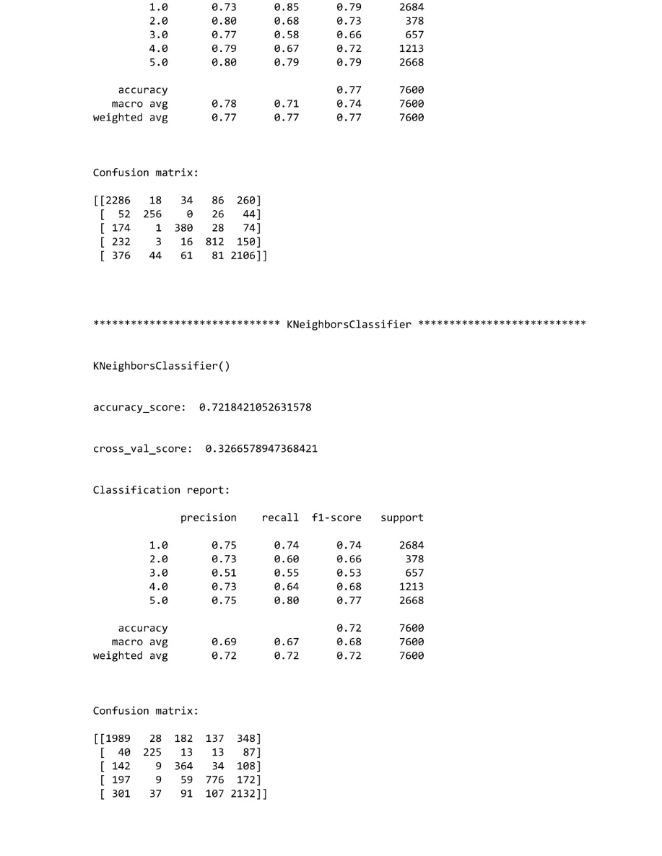
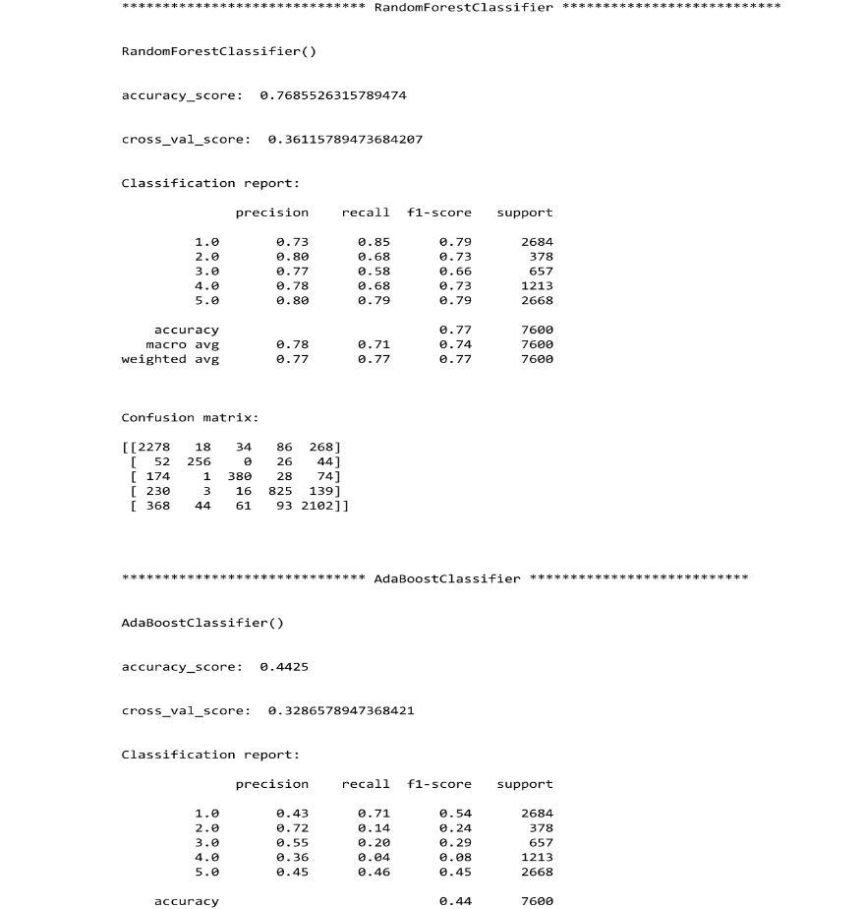
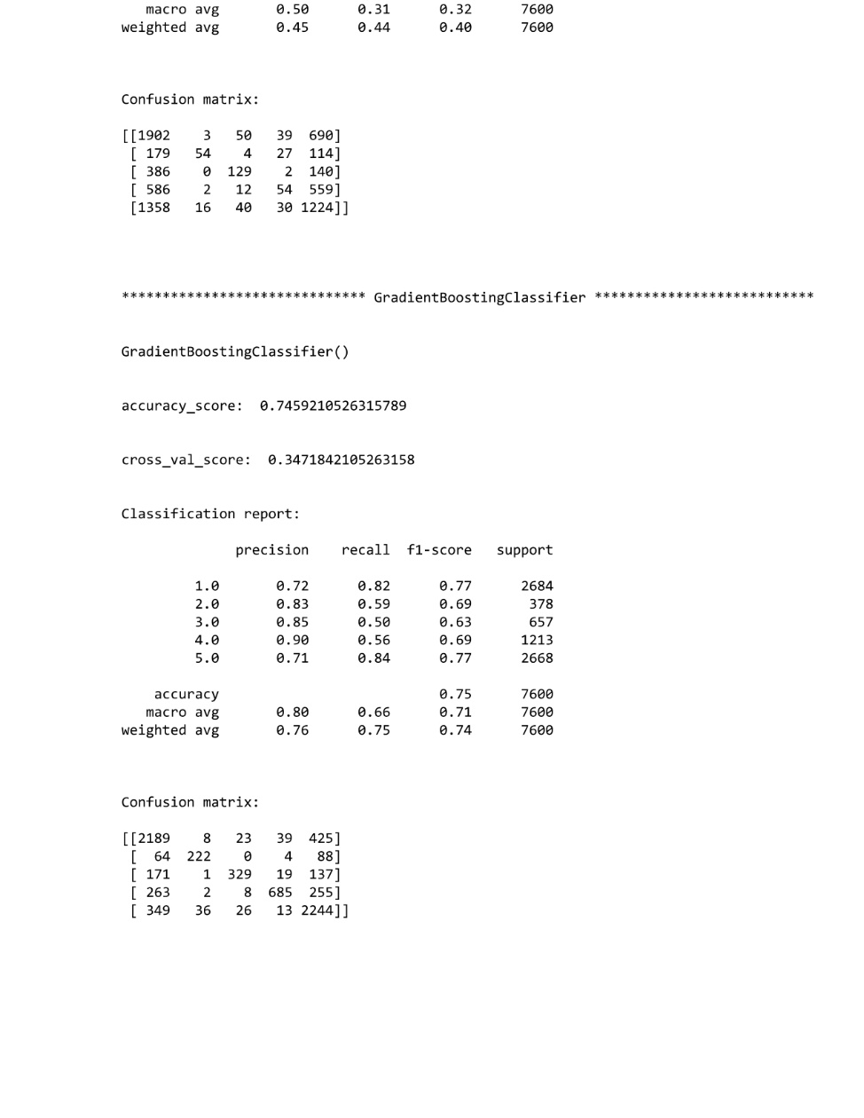
Evaluating the best Model

Slide 23
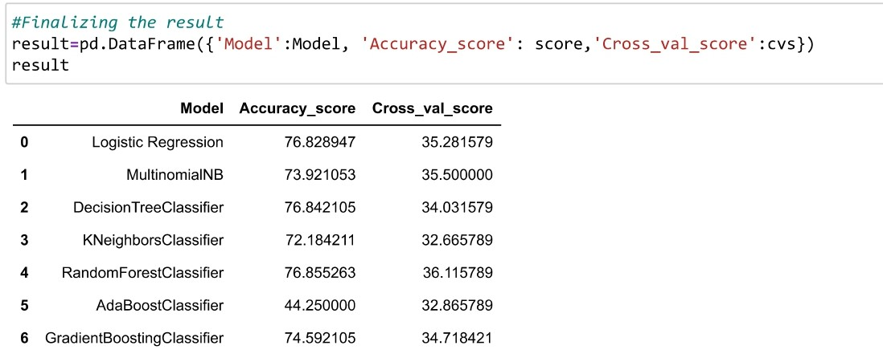
Figuring best among them

Slide 24
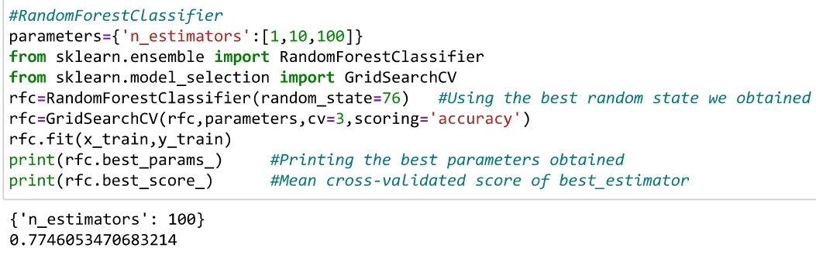
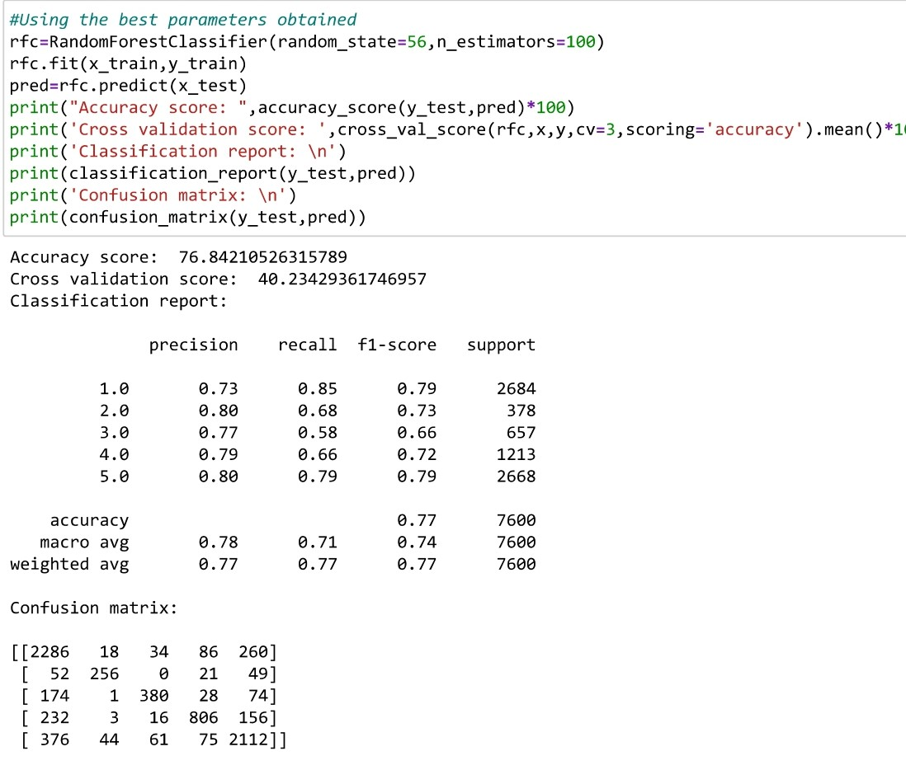
HyperTuning The Model

Slide 25
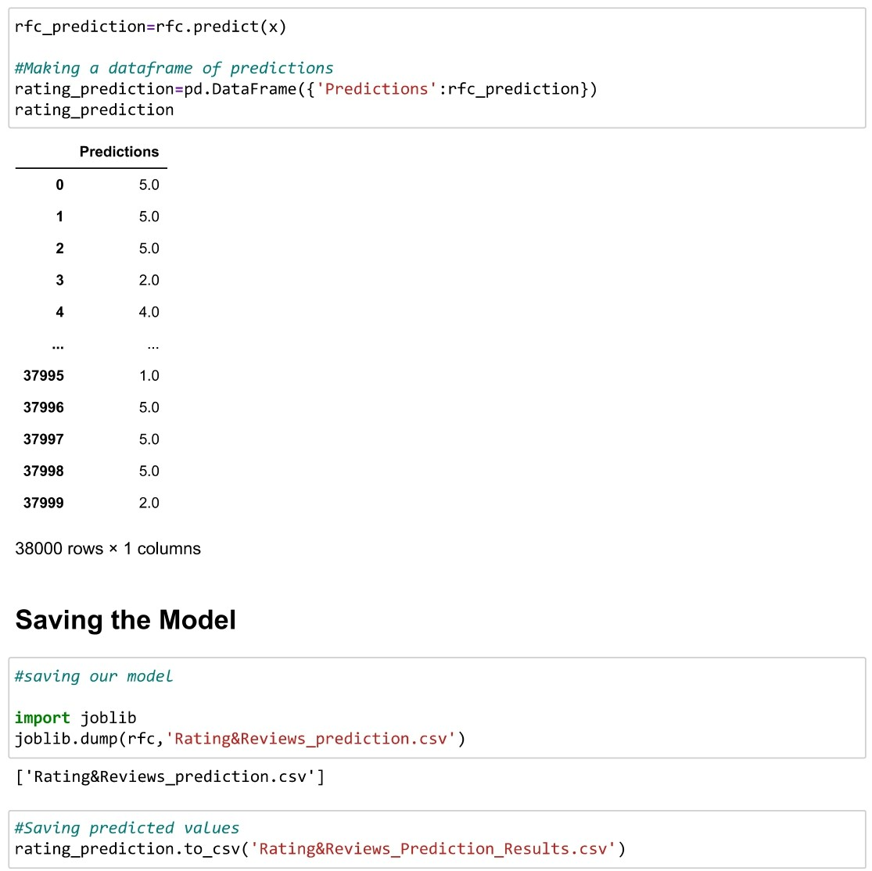
Finalizing the model

Slide 26
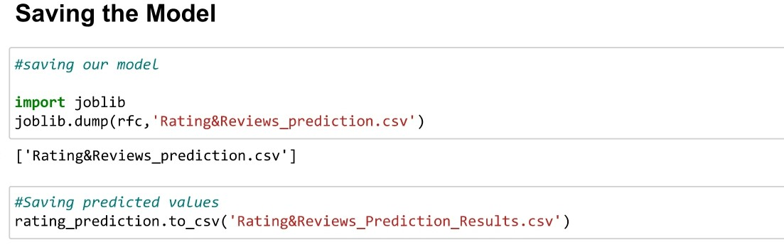

Slide 27
Summary
After the completion of this project, we got an insight of how to collect data, preprocessing the data, analyzing the data and building a model.
1.we collected the reviews and ratings data from e-commerce website Amazon it was done by using Webscraping. The framework used for webscraping was Selenium, which has an advantage of automating our process of collecting data.
2.We collected almost 36000+ of data which contained the ratings from 1.0 to 5.0 and their reviews.
3.en, the scrapped data was combined in a single dataframe and saved in a csv file so that we can open it and analyze the data.

Slide 28
4.We did the preprocessing using NLP and the steps are as follows:
a.Removing Punctuations and other special characters
b.Splitting the comments into individual words
c.Removing Stop Words
d.Stemming and Lemmatising
e.Applying Count Vectoriser
f.Splitting dataset into Training and Testing

Slide 29
5.After separating our train and test data, we started running different machine learning classification algorithms to find out the best performing model.
6.We found that RandomForest is performing well, according to their accuracy and cross val scores.
7.Then, we performed Hyperparameter Tuning techniques using GridSearchCV for getting the best parameters and constant the scores. In that, RandomForestClassifier performed well and we finalised that model.
8.We saved the model and then saved the predicted values in a csv format.
9.The problems we faced during this project were:
a.More time consumption during hyperparameter tuning for model, as the data was large.

Slide 30
b.Less number of parameters were used during tuning.
c.Scrapping of data from different websites were of different process and the length of data were differing in most cases so I sticked to Amazon and Scrapped data which are famousin the site.
d.Some of the reviews were bad and the text had more wrong information about the product.
e.WordCloud was not showing proper text which had more positive and negative weightage.
10.Areas of improvement:
a.Less time complexity
b.More accurate reviews can be given
c.Less errors can be avoided.

Slide 31


